Slide 1
How much did it rain in Ames on 25 June 2010?
daryl herzmann
Department of Agronomy

Slide 2
Anybody remember what happened that day?
Answer: NOTHING

Slide 3

A presentation about “Nothing” Goals
To confuse you:
Provide over 18 answers to the posed question!!!
To inform you:
Highlight data made available by the Iowa Environmental Mesonet
To bore you:
Go into the excruciating minutiae of precipitation reporting
Link: breadcrumb trail

Slide 4
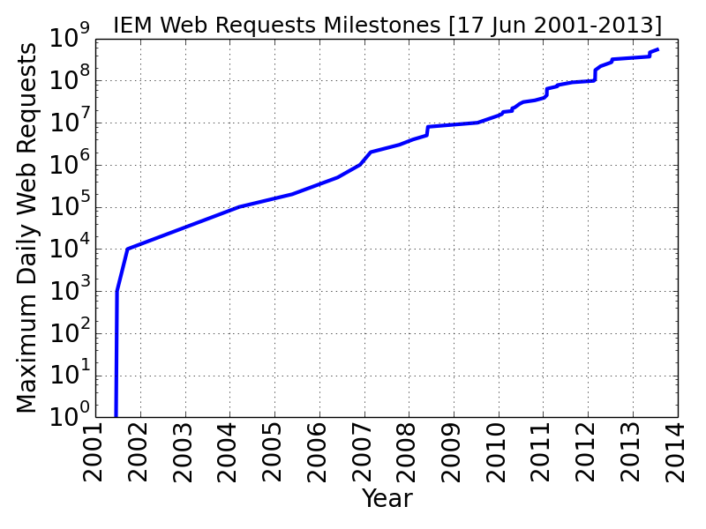
Iowa Environmental Mesonet (IEM)
ISU Agronomy data collection effort since 2001.
Most trafficked ISU research website.
Our website is a confusing collection of rabbit holes.
We are data pigs.
Dr Ray Arritt, supervisor

Slide 5
How much did it rain in Ames on 25 June 2010?
Good, the past! We should know what happened.
Quantitative, Yes we can do that!
Central Post Office?
Incorporated Polygon?
Airport?
Flory’s House?
UTC Day?
Calendar Day?
Daylight Hours?
Some 24 Hour period?

Slide 6
What is precipitation?
“the action or process of precipitating a substance from a solution.”
So “water”, in any phase, leaving the air and delivered to the ground
Dew is a form of precipitation
The Ground

Slide 7
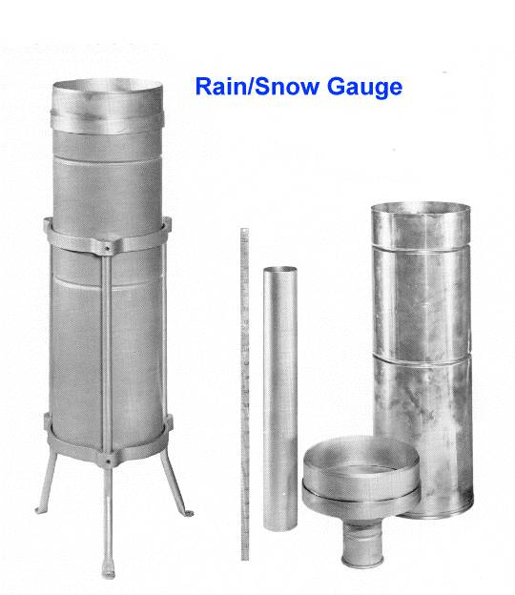
How do we measure precipitation?
Manual gauge
Official NWS gauge has an 8 inch diameter opening and 0.01 inch precision
Nearly all sites are once per day reporting
Automated gauge
Typically 0.01 inch precision, but many caveats
Neighbor Extrapolation
“My neighbor got 3 inches last night and I got a bit less than that, so I got 2.5 inches”
Precipitation is a flux: amount of stuff per unit area per some amount of time
Typically express as an accumulated depth
Image Source: http://i4weather.net

Slide 8
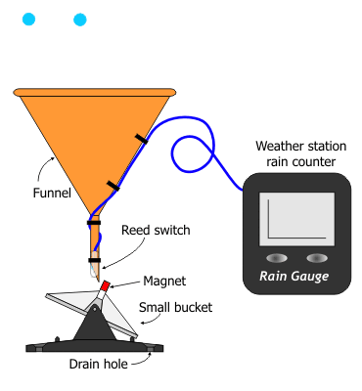
Tipping Bucket Rain Gauge
Each tip is 0.01 inch
Some are “heated” to melt frozen precip in funnel
Intense rainfall rates ~2.5 inches/hr lead to under-reporting
Adapted from http://weather.about.com

Slide 9
Enough introduction, let us have at it.

Slide 10
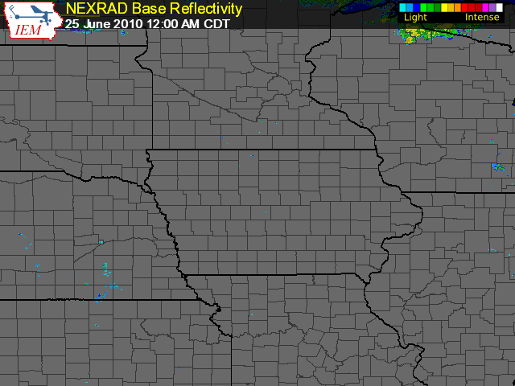
We are here!
Link: Current -> RADAR -> Composite Loop

Slide 11
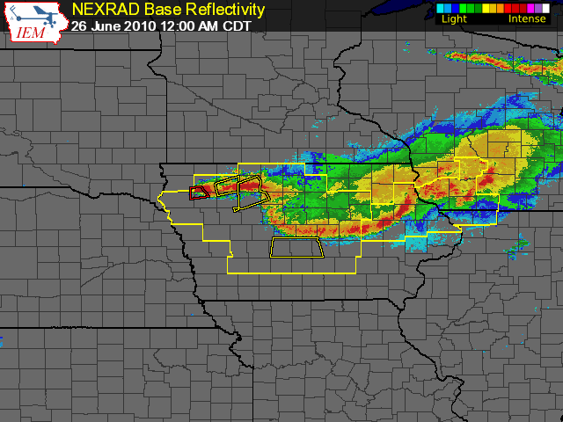
It would appear to be raining in Ames at midnight, oh joy!

Slide 12
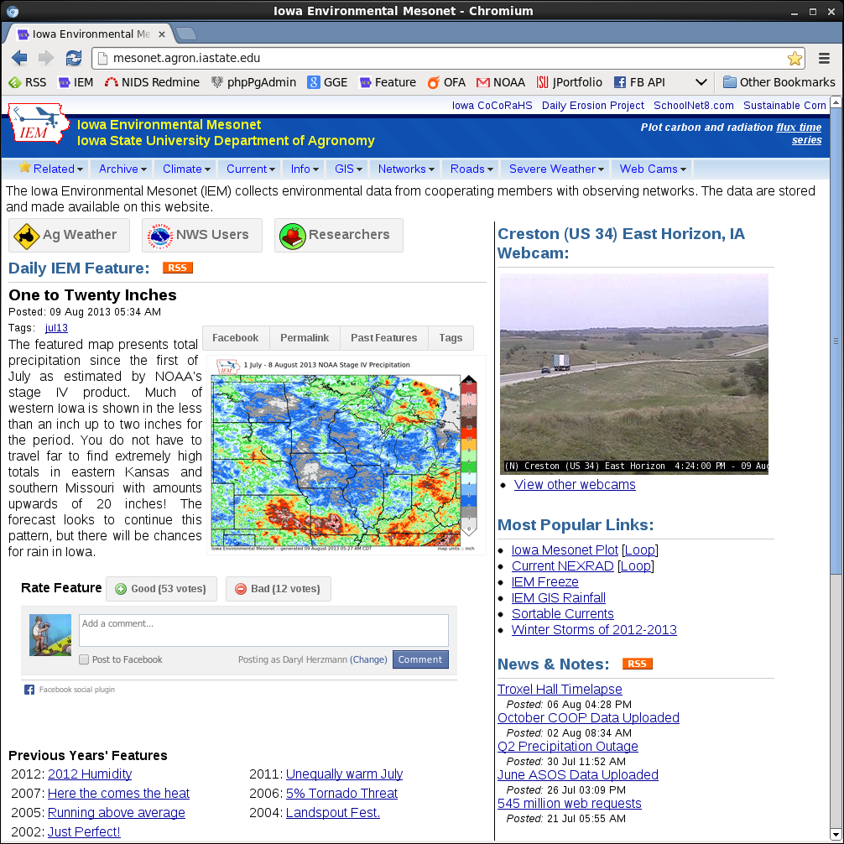

Slide 13
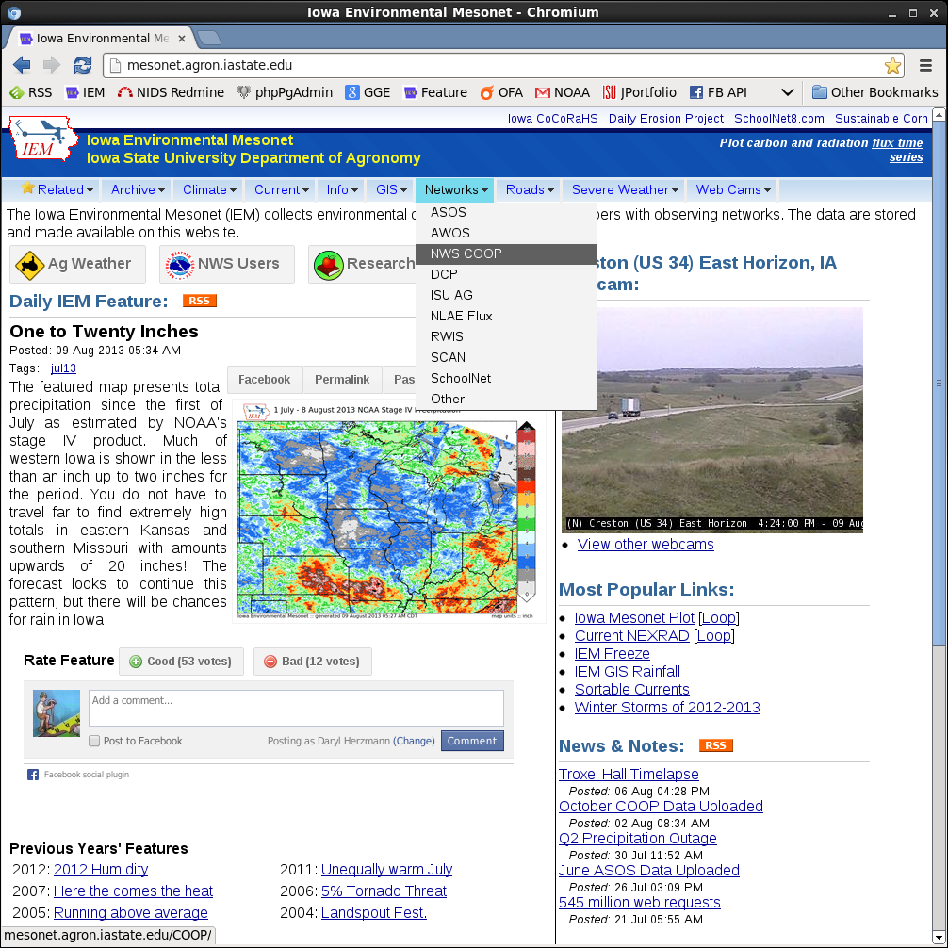

Slide 14
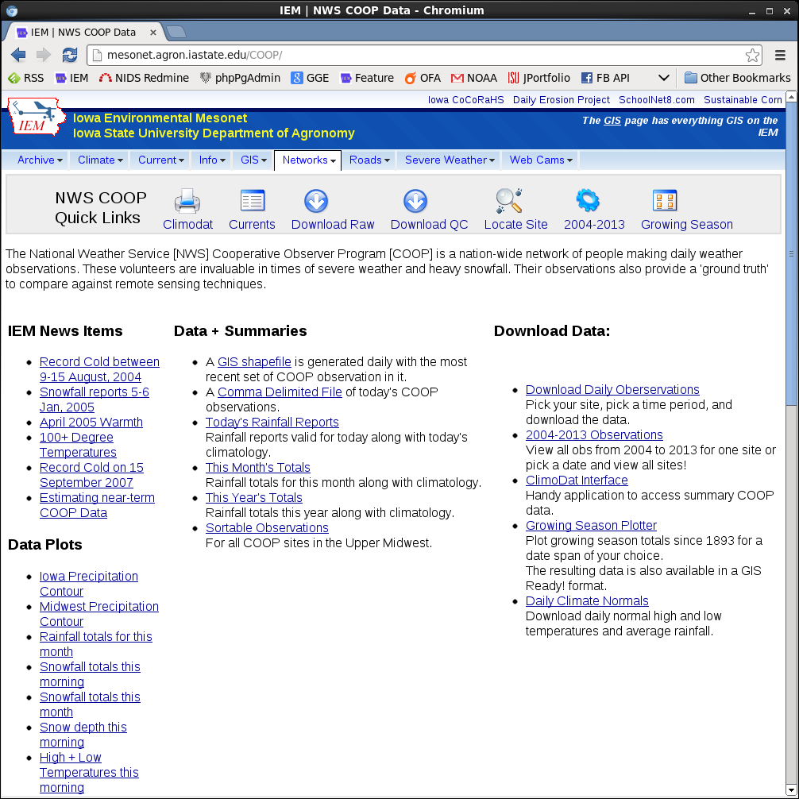

Slide 15
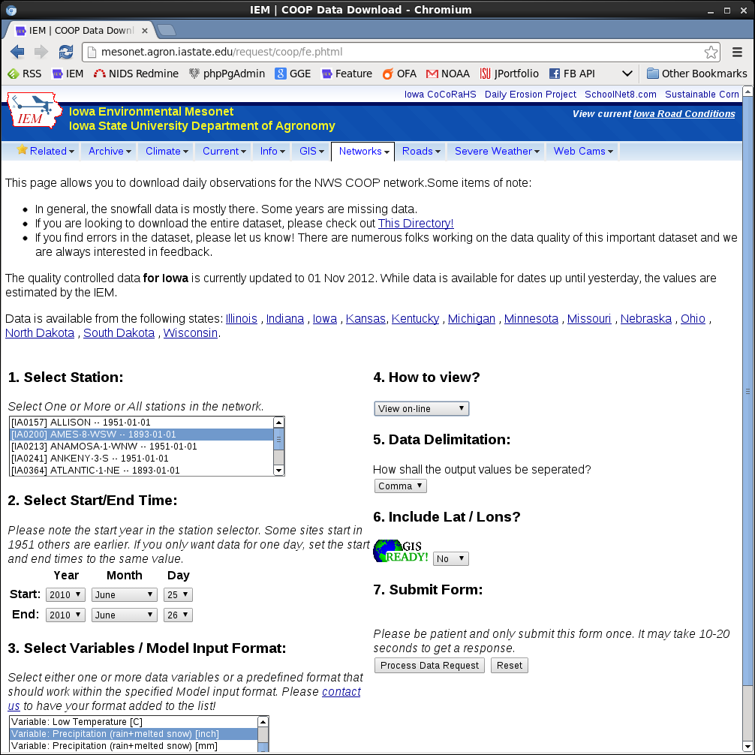

Slide 16
And the answer is…
station | station_name | day | julianday | precip
IA0200 | AMES-8_WSW | 2010/06/25 | 176 | 0
Link: Networks -> COOP -> Download QC

Slide 17
Whiskey Tango Foxtrot
station | station_name | day | julianday | precip
IA0200 | AMES-8_WSW | 2010/06/25 | 176 | 0
This is from the ISU Agronomy Farm, which is outside of Ames!
Link: Networks -> COOP -> Download QC

Slide 18
NWS Cooperative Network
Once daily observations typically at 7 AM with 24 hour totals
Precipitation is typically very high quality due to manual collection
IEM’s “quality controlled” archive is provided by State Climatologist, who attempts to align data to calendar day!

Slide 19
Ames :: Automated Surface Observation System (ASOS)
station | valid (local timezone) | p01i
AMW | 2010-06-25 11:36 PM | M
AMW | 2010-06-25 11:53 PM | 0.13
AMW | 2010-06-26 12:10 AM | 0.46
AMW | 2010-06-26 12:33 AM | 0.72
AMW | 2010-06-26 12:43 AM | 0.88
AMW | 2010-06-26 12:53 AM | 0.97
AMW | 2010-06-26 12:59 AM | 0.01
Precipitation is hourly accumulation since last rest at :53 after.
0.46” fell between 11:53 PM and 12:10 AM. So we don’t know!
Link: Networks -> ASOS -> Download

Slide 20
ASOS produces an explicit Daily Summary Message (DSM), our problems are solved!
KAMW DS 25/06 871615/610459//87/61//9761919/111/00/00/00/00/00/00/00/00/00/00/00/00/00/00/00/00/00/00/00/00/00/00/33/78/87/01322222/36412227/13=
“Daily” Total of 1.11 inches, case closed!
Link: Current -> NWS Text Archive -> Enter DSMAMW

Slide 21
ASOS Daily Summary Message (DSM)
Gotcha. The daily summary message is for a 12 AM to 12 AM period in local standard time, so in daylight time, it is 1 AM to 1 AM!
KAMW DS 25/06 871615/610459//87/61//9761919/111/00/00/00/00/00/00/00/00/00/00/00/00/00/00/00/00/00/00/00/00/00/00/33/78/87/01322222/36412227/13=
11 PM to Midnight total: 0.33
Link: Current -> NWS Text Archive -> Enter DSMAMW

Slide 22
ASOS One Minute Interval Data
Station | valid | precip
AMW | 11:46 PM | 0.01
AMW | 11:47 PM | 0
AMW | 11:48 PM | 0.02
AMW | 11:49 PM | 0.01
AMW | 11:50 PM | 0.02
AMW | 11:51 PM | 0.01
AMW | 11:52 PM | 0.02
AMW | 11:53 PM | 0.04
AMW | 11:54 PM | 0.02
AMW | 11:55 PM | 0.03
AMW | 11:56 PM | 0.03
AMW | 11:57 PM | 0.04
AMW | 11:58 PM | 0.04
AMW | 11:59 PM | 0.05
AMW | 12:00 AM | 0.05
Get out your calculator.
0.33” prior to 12:00 AM
When did this 0.05” fall?
11:59 PM to 12:00 AM
or
12:00 AM to 12:01 AM ?
Link: Networks -> ASOS -> One Minute Download

Slide 23
Answer is neither!
ASOS timestamps are not exact at :00 seconds, but :23 seconds after.
So 12:00 AM observation is a period from 11:59:24 PM to 12:00:23 AM
So we’ll split the 0.05” report in half and round up!
Link: Networks -> ASOS -> Note About Precip Timing

Slide 24
Daryl, this is more tedium than I care for.
Let us put aside these issues going forward:
Exact seconds timing of data
Issues with tipping bucket latency

Slide 25
KCCI-TV SchoolNet @ St Cecilia
datetime | pday
11:40 PM | 0.01
11:55 PM | 0.43
11:56 PM | 0.46
11:57 PM | 0.49
11:58 PM | 0.52
11:59 PM | 0.55
12:00 AM | 0.57
12:01 AM | 0.59
12:02 AM | 0.01
Data is streamed live to IEM, which places timestamps on the data. So 0.57” reported was reported at midnight…
Actual reset came two minutes later as the logger clock on site is off!
Link: Networks -> SchoolNet -> Download

Slide 26
Ames Roadway Weather Information System
datetime | pcpn
11:22 PM | 0
11:33 PM | 0
11:43 PM | 0
11:52 PM | 0
12:06 AM | 0
12:12 AM | 0
Maintained by Iowa Department of
Transportation.
Some sites have an optical precipitation sensor. The Ames site does but did not report precip?
Link: Networks -> RWIS -> Download

Slide 27
USGS Squaw Creek at Lincoln Way
datetime | HG | PCI | PPH
11:00 PM | 2.51 | 0 | 0
11:15 PM | 2.51 | 0
11:30 PM | 2.51 | 0
11:45 PM | 2.51 | 0
12:00 AM | 2.56 | 0 | 0
12:15 AM | 2.84 | 0
12:30 AM | 3.05 | 0
12:45 AM | 3.15 | 0
1:00 AM | 3.14 | 0 | 0
While the sensor reported a change in stream flow (HG), the precipitation counter (PCI) and hourly precipitation (PPH) reported zero.
Link: Networks -> DCP -> Download

Slide 28
USGS Skunk River near Ada Hayden
datetime | HG | PCI | PPH
11:00 PM | 4.53 | 13.76 | 0
11:15 PM | 4.52 | 13.76
11:30 PM | 4.51 | 13.76
11:45 PM | 4.55 | 14.04
12:00 AM | 4.61 | 14.69 | 0.93
12:15 AM | 4.64 | 14.89
12:30 AM | 4.64 | 15.05
12:45 AM | 4.66 | 15.12
1:00 AM | 4.67 | 15.16 | 0.47
Whew, we have a station that appears to be working!
Link: Networks -> DCP -> Download

Slide 29
USGS Skunk River near Water Treatment Plant
datetime | HG | PCI | PPH
11:00 PM | 11.92 | 39.14 | 0
11:15 PM | 11.92 | 39.14
11:30 PM | 11.92 | 39.14
11:45 PM | 11.92 | 39.14
12:00 AM | 11.96 | 39.61 | 0.47
12:15 AM | 12.03 | 39.89
12:30 AM | 12.2 | 40.02
12:45 AM | 12.38 | 40.22
1:00 AM | 12.57 | 40.3 | 0.79
Another site that appears to be working just fine!
Link: Networks -> DCP -> Download

Slide 30
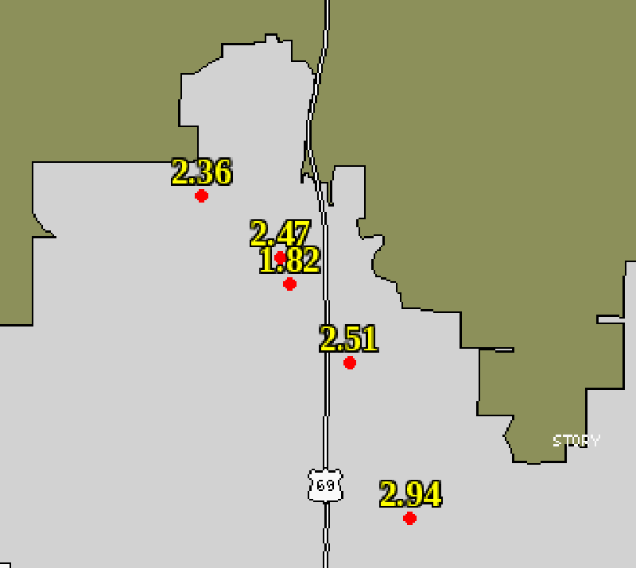
CoCoRaHS 24 Hour totals for morning of June 26th
Human volunteers that report once daily, around 7 AM.
Link: Iowa CoCoRaHS -> View Observations

Slide 31
ISUAG Station at AgFarm
datetime | Hourly Precip | Flag
11:00 PM | 0 | e
12:00 AM | 0.25 | e
01:00 AM | 0.48 | e
Precipitation data from this network is almost always estimated by High Plains Climate Center.
Link: Networks -> ISUAG -> Daily Download

Slide 32
Honorable Mentions
Site | Precipitation
NRCS Scan Site | Offline
Agronomy Hall Wx Station | 0.52
Agronomy Hall AMS Station | 0.53
Dave Flory’s House | 0.54
NLAE Beliot Station | 0.52
Link: Networks -> Other

Slide 33
Halftime Report
Have we definitively answered the initial question yet? -No
Individual station data is yucky, so we produce gridded analyses to make pretty pictures

Slide 34


RAdio Detection And Ranging (RADAR)
National Weather Service RADAR is an effective tool at seeing raindrops, birds, bugs, planes, and wind turbines.
RADAR does not observe precipitation!
RADAR measures power returned, which is put into equations to estimate precipitation.
RADAR
Big Bird: Public Domain USGOV
Turbine: CCSA by lukipuk

Slide 35
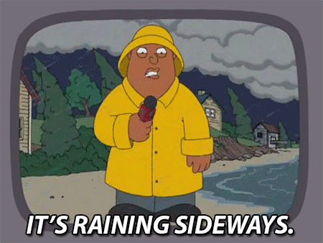
RADAR is above our heads
The Des Moines RADAR “beam” is about 1,000 feet above the ground over Ames.
~30 seconds for drop to reach the ground
Does not account for drift
1. EM wave goes out at 0.5° elevation
RADAR
3. Drops have to survive trip to ground
2. Earth curves away
Tumblr:
windexwaker

Slide 36
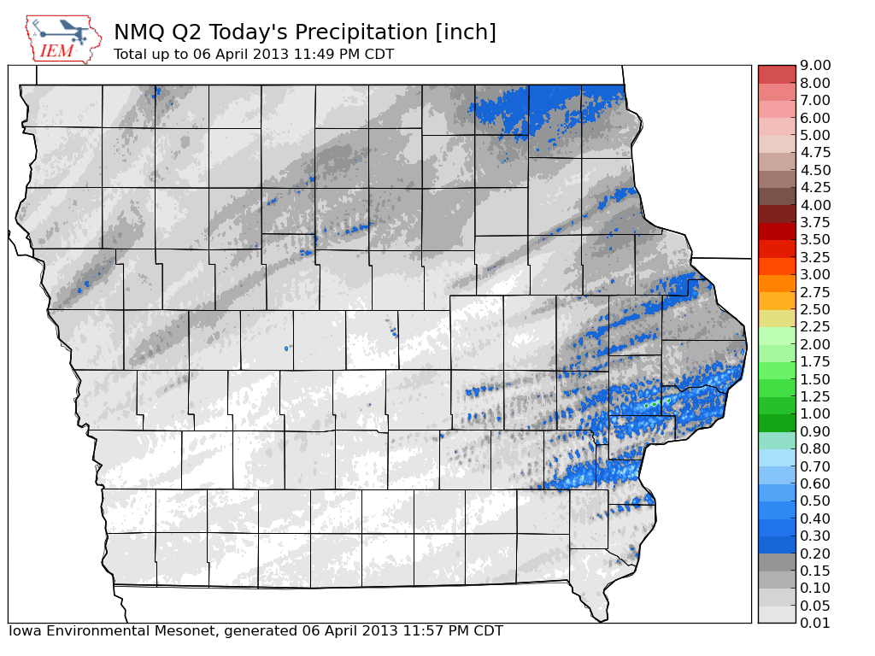
Courant Number
Time step / Grid needs to be large enough to prevent storms from skipping over grid cells
1km grid spacing
5 minute time step
Max speed: 1000/300 = 3.3 m/s

Slide 37
Even more RADAR caveats
Recall our recent discussion of ASOS providing four different answers to one question.
Guess what, RADAR does the same!
Most rainfall products are 4 bit data! 16 levels
The timing of 1 hour total precipitation product is nebulous at best.
Different rainfall products are not directly comparable.

Slide 38
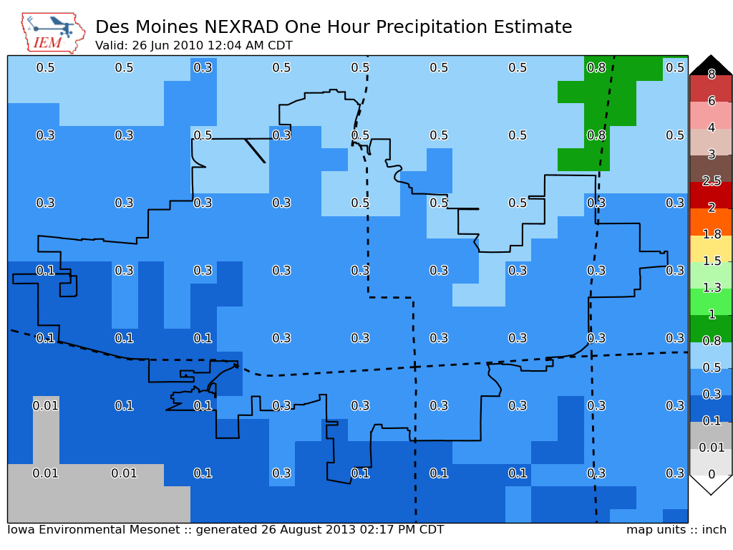
Link: GIS -> Rainfall

Slide 39
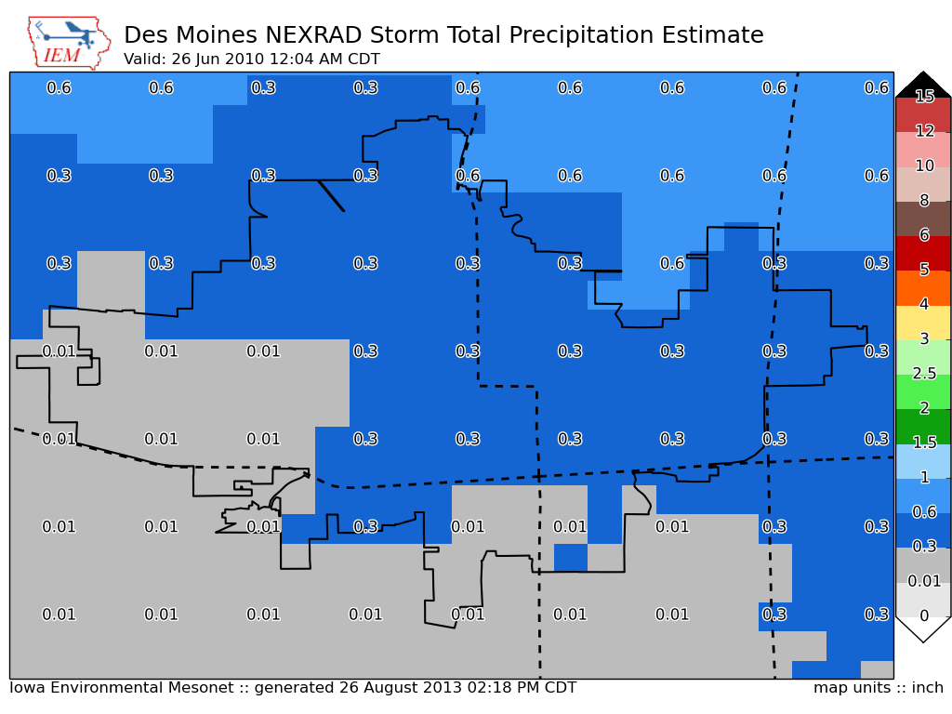
Link: GIS -> Rainfall

Slide 40
Discrete Levels (in inches)
One Hour Precipitation Bins
Storm Total Precipitation Bins
No Data | 1.5
Trace | 1.8
0.1 | 2.0
0.3 | 2.5
0.5 | 3.0
0.8 | 4.0
1.0 | 6.0
1.3 | 8.0
No Data | 3.0
Trace | 4.0
0.3 | 5.0
0.6 | 6.0
1.0 | 8.0
1.5 | 10.0
2.0 | 12.0
2.5 | 15.0

Slide 41
NCEP Stage IV Precipitation
Popular mosaicked dataset combining manual quality control, RADAR data, and point observations.
Caveat: Hourly data is rarely quality controlled!
The best product is a 24 hour total between 12 UTC and 12 UTC (7 AM), not calendar day!
Link: Archive -> Browse Archive

Slide 42
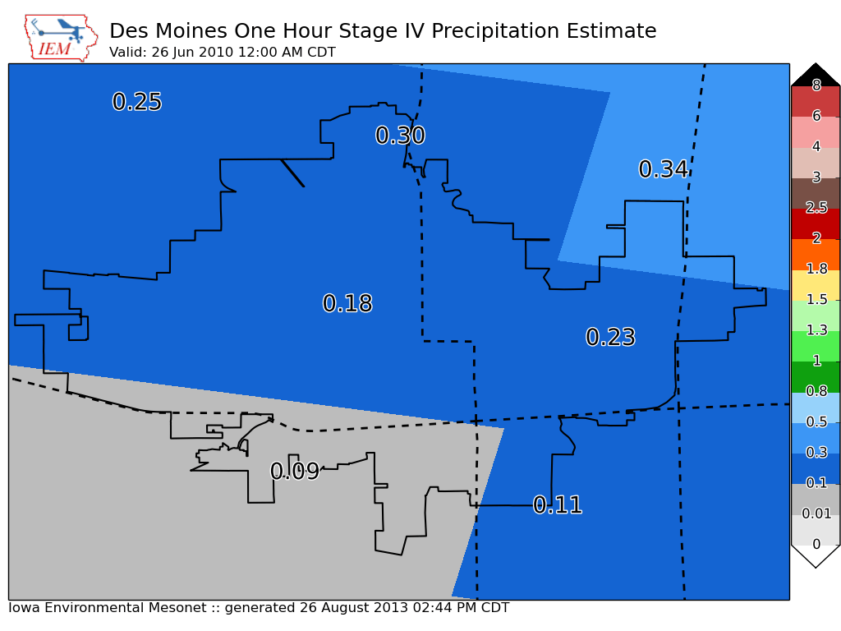

Slide 43
North American Reanalysis (NARR)
Retrospective combination model and data assimilation dating back to 1 Jan 1979
3 hour interval data
32 km grid spacing
Ames fits within one grid cell.
Link: Archive -> NARR NCDC NOMADS Site

Slide 44
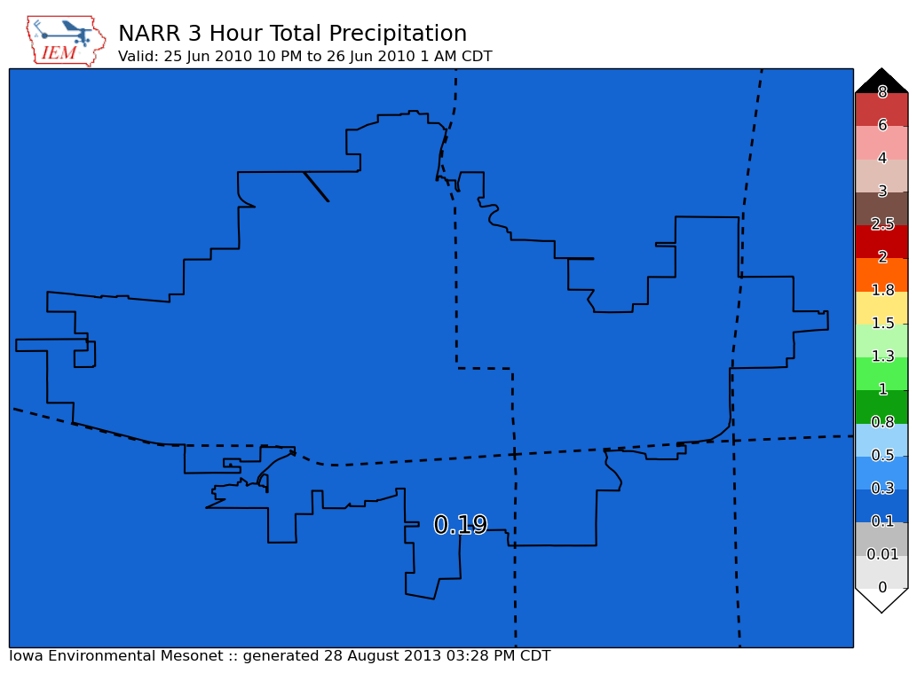

Slide 45
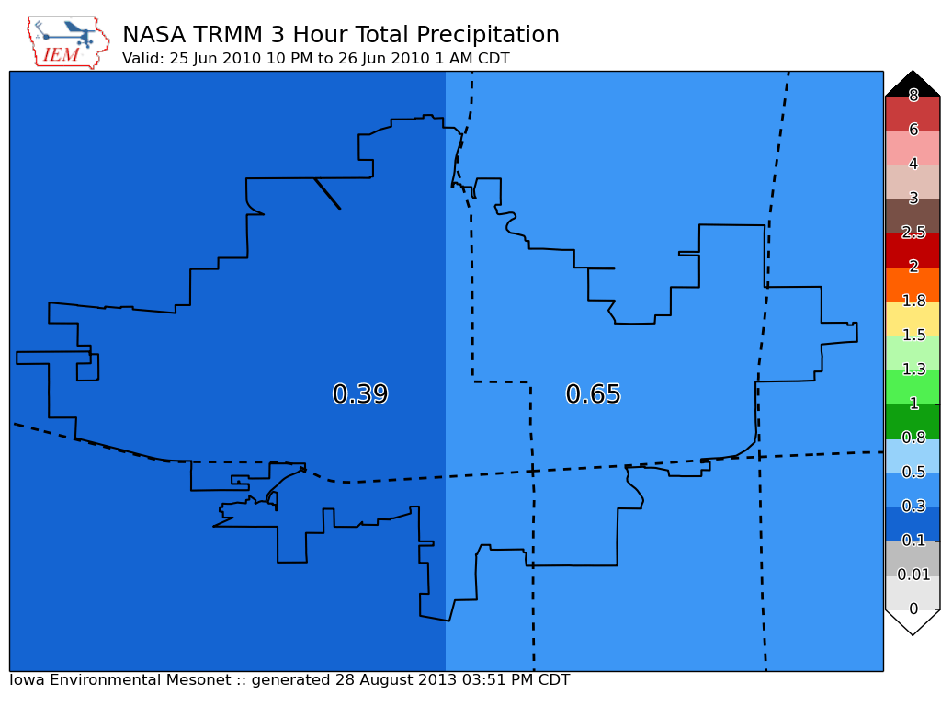

Slide 46
And the answer is….
IEM QC COOP | 0.00 | SchoolNet | 0.57 | CoCoRaHS | ??? | Stage IV | 0.22
ASOS | 0.13 | RWIS | 0 ? | ISUAG AgFm | 0.25 | NARR | 0.19
ASOS DSM | 1.11 | Lincoln Way | 0 ? | Others | 0.53 | TRMM | 0.51
ASOS DSM Hr | 0.33 | Ada Hayden | 0.93 | DMX 1hr | 0.30
ASOS 1min | 0.36 | H2O Trtment | 0.47 | DMX Storm T | 0.25
We simply average and get: 0.36176470588 inches! What precision!

Slide 47
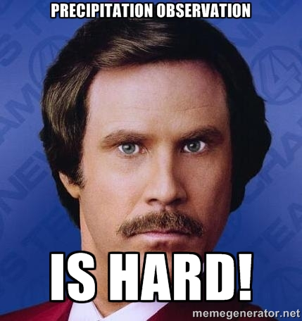
In Summary
Know your application and source of precipitation data before using it.
The hope is that irregularities at small time scales even out in time.
If you think Meteorologists are always wrong, none of this mattered to you!

Slide 48

Be sure to be with us next time for:
Was it cloudy at sunrise on 15 November 2003?
What was the air temperature at 4 PM on 10 February 2013?
Will it ever rain in Ames again?
Source: DVD of The Rocky & Bullwinkle Show

Slide 49

Questions?
Daryl Herzmann
3015 Agronomy
515.294.5978
akrherz@iastate.edu @akrherz

